Slide 1

8051 Example

Slide 2
EXP 1: LED Blink
Call delay function in main loop
Use GPIO to make LED blink
Interface
GPIO (Output)

Slide 3
EXP 2: 7-Segment Display
Call delay function in main loop
Show 3210 with 7-Segment Display
Interface
GPIO (Output)

Slide 4
EXP 3: Control LED by Buttons
Key Scan Mechanism
Switch LED On/Off with key pressed
Interface
GPIO (Input/Output)

Slide 5
EXP 4: Increase Values by Buttons
Value adds 1 when the key is pressed
Display the value with 7-segment display
Interface
GPIO (Output)
External Interrupt

Slide 6
EXP 5: Display Key Value in Hex Form
Display the Key value in Hex form with 7-segment display
Interface
GPIO (Output)
External Interrupt

Slide 7
EXP 6: Countdown the Time
Enable Timer0 1-sec interrupt
Counter value minus 1 in Timer0_ISR
Display the counter value with 7-segment display
Interface
GPIO (Output)
Timer0 (Interrupt)

Slide 8
EXP 7: Measure Voltage on Potentiometer
Display the ADC measured value with 7-segment display
Interface
GPIO (Output)
Timer0 (Interrupt)

Slide 9
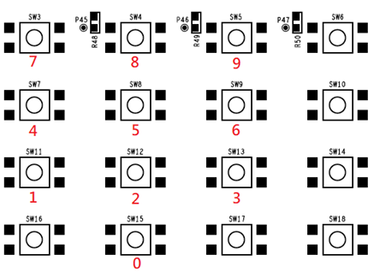
EXP 8: Adjust Pitch of the Buzzer
Adjust the pitch of the buzzer with Buttons
Interface
GPIO (Input)
External Interrupt
PWM

Slide 10
EXP 9: UART Transceiver
UART MODE 1
Baud rate 9600
Receive then Transmit the same character
Interface
UART

Slide 11
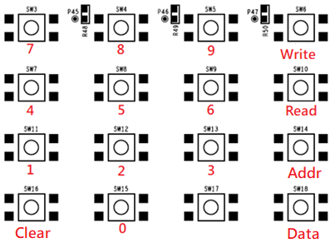
EXP 10: R/W SPI Flash with Button Matrix
Read/write SPI Flash with Button matrix.
Interface
GPIO (Input)
External Interrupt
SPI (Master mode 0)

Slide 12
EXP 11: R/W EEPROM with Button Matrix
Read/write EEPROM with Button matrix.
Interface
GPIO (Input)
External Interrupt
I2C (Master mode)

Slide 13
Core Competence
Precise lead time in the consumer IC industry
Competitive pricing by implementing advanced IC circuit & system design
Custom ICs to meet customer’s projects
Extensive agent offices for sales and technical support
建議字型：中文字型- 微軟正黑體 ； 英文字型 - Verdana
會議室投影建議：內文最小字型建議至少14級字
配色參考：

Slide 14

Thank You

